Slide 1
Class Test 2 Class-wide Feedback
Mark distribution
Answer distribution
Issues (not many, really)

Slide 2
Marks

Slide 3
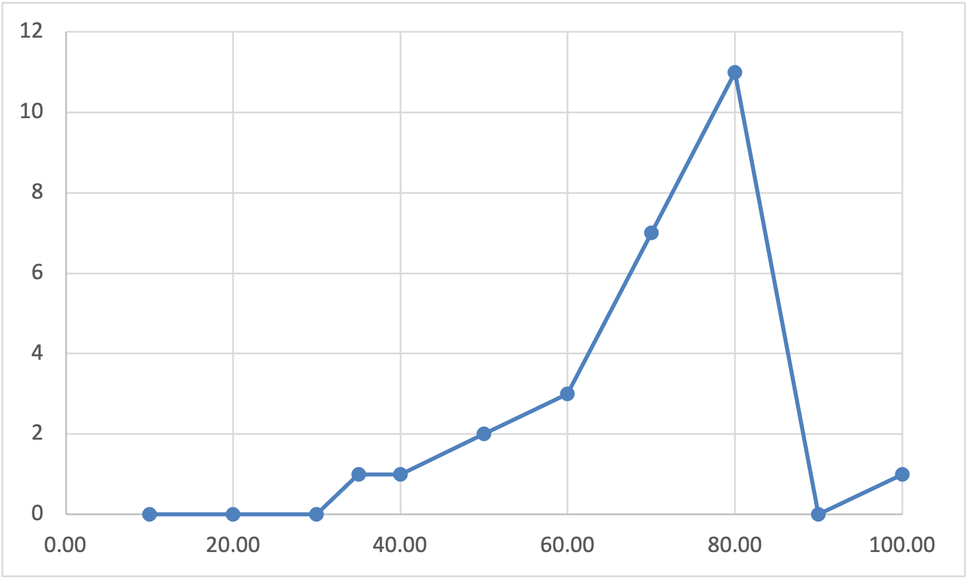
Mark Distribution
26/34 took part
Average 65% (Median 67%)

Slide 4
Mark Distribution
A lot better than the first test.
No fat tail, many people got
distinction marks.

Slide 5
Mark Distribution
Attendance still not too good,
but
It did not go down, and
It was a lot better than attendance to meetings (Q&A sessions or tutorials)

Slide 6
This has gone down
From 0.66 in test 1.
Notes:
This has gone done from 0.66 for test1 … to 0.47, showing that studying a module is not just about web browsing.

Slide 7
Questions

Slide 8
Notes:
This diagram shows, for each question, the average percentage mark, and the proportion of people who answered that question (among those who got that question)

Slide 9
Questions
Web Information Retrieval
Popular
Notes:
Web Information Retrieval definitely most popular … but not necessarily best performing! (There were occasional misunderstandings about Pagerank.

Slide 10
Questions
Web Information Retrieval
Smaller Mark
Variability
Notes:
Web Information Retrieval definitely most popular … but not necessarily best performing! (There were occasional misunderstandings about Pagerank.

Slide 11
Questions
Questions with less
Than 40% attempts

