Slide 1
2021-22: Class Test 1 Class-wide Feedback
General Statistics
Mark distribution
Answer distribution
Comparisons with 2018-19, 2019-20, and 2020-21

Slide 2
Module Data
YEAR | CLASS SIZE | ASSESSMENT SETUP | AVERAGE MARK: over the whole class (over engaging students)
2018-19 | 77 | On campus. Tests: 10%, 10% Exam: 80% | 57% (68%)
2019-20 (Covid) | 44 | On campus only class test 1. Tests: 10%, 10% Exam: 80% | 65.1% (73.4%)
2020-21 (Covid) | 50 | On-line. Tests: 10%, 12%, 18% Exam: 60% | 55.5% (66.8%)
2021-22 | 34 | On-line tests. Tests: 12%, 18% Exam: 70%

Slide 3
Marks

Slide 4
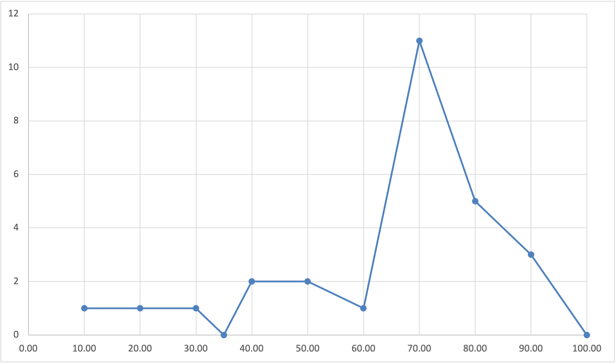
Mark Distribution
27/34 took part (but one no-submission)
Average 59.1% (Median 63%)

Slide 5
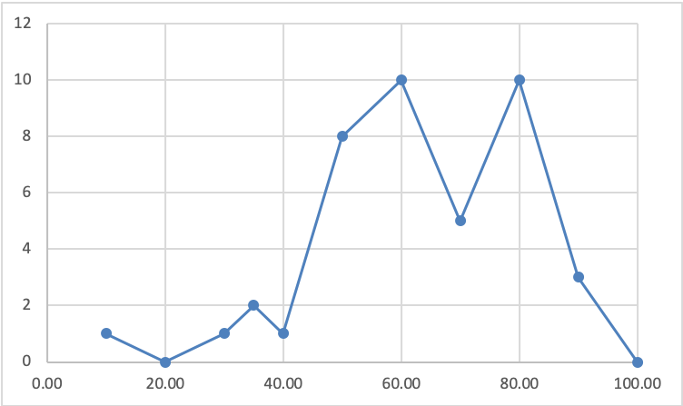
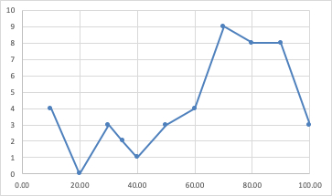
Mark Distribution Comparing with the past
(2020)
44/45 took part
Average 55% (Median 59%)
(2019)
64/77 took part
Average 59% (Median 61%)
(2021)
45/50 took part (but few did not submit anything)
Average 59.6% (Median 67%)
Notes:
Mark distribution has average similar to previous years’ but it’s more concentrated (the tails, at the two ends, are smaller).

Slide 6
Mark Distribution Issues
8/27
Notes:
The lower tail is still somewhat fat.

Slide 7
Mark Distribution Issues
7/34 (20% of the class)
Did not turn up!
Notes:
In summary: 12 people (more than a third of the class) either did not attempt or failed the first class test.

Slide 8
Notes:
Slightly more interesting. This table is correlating the test marks with the number of page hits until April 3rd.

Slide 9
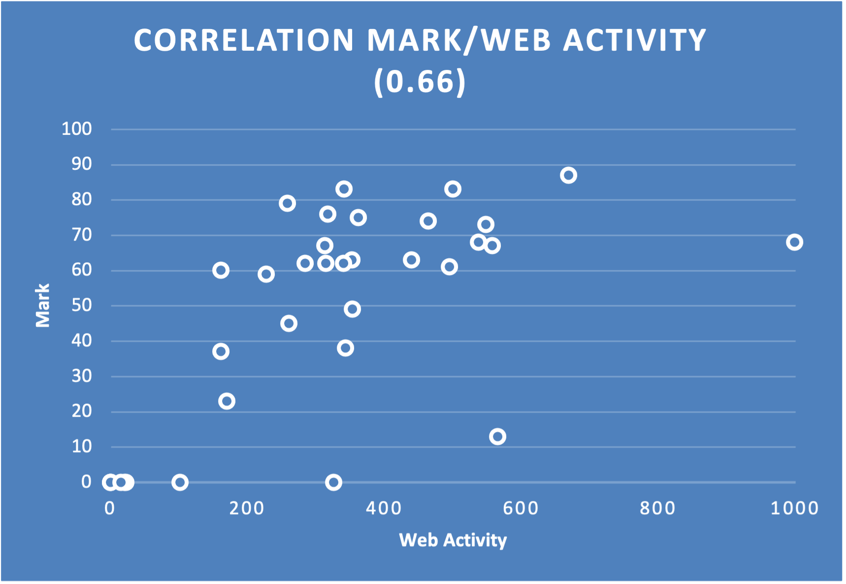
“ALMOST ALL” failing marks are
from people who did not really looked
much at the material on CANVAS

Slide 10
With the exception of a single outlier, no
person with more than 400 clicks at the CANVAS
material got less than a B
Notes:
STAYING ON REALLY PAYS OFF!

Slide 11
Questions

Slide 12
Questions
Notes:
This diagram shows, for each question, the average percentage mark, and the proportion of people who answered that question (among those who got that question)

Slide 13
Questions
Questions with less
Than 40% attempts
Notes:
Few questions were not very popular, mostly from Unit 5.

Slide 14
Questions
These ones got
no takers!

Slide 15
Questions
Questions with more
than 80% attempts (all
from Units 1 – 3)
Notes:
Few others were very popular.

Slide 16
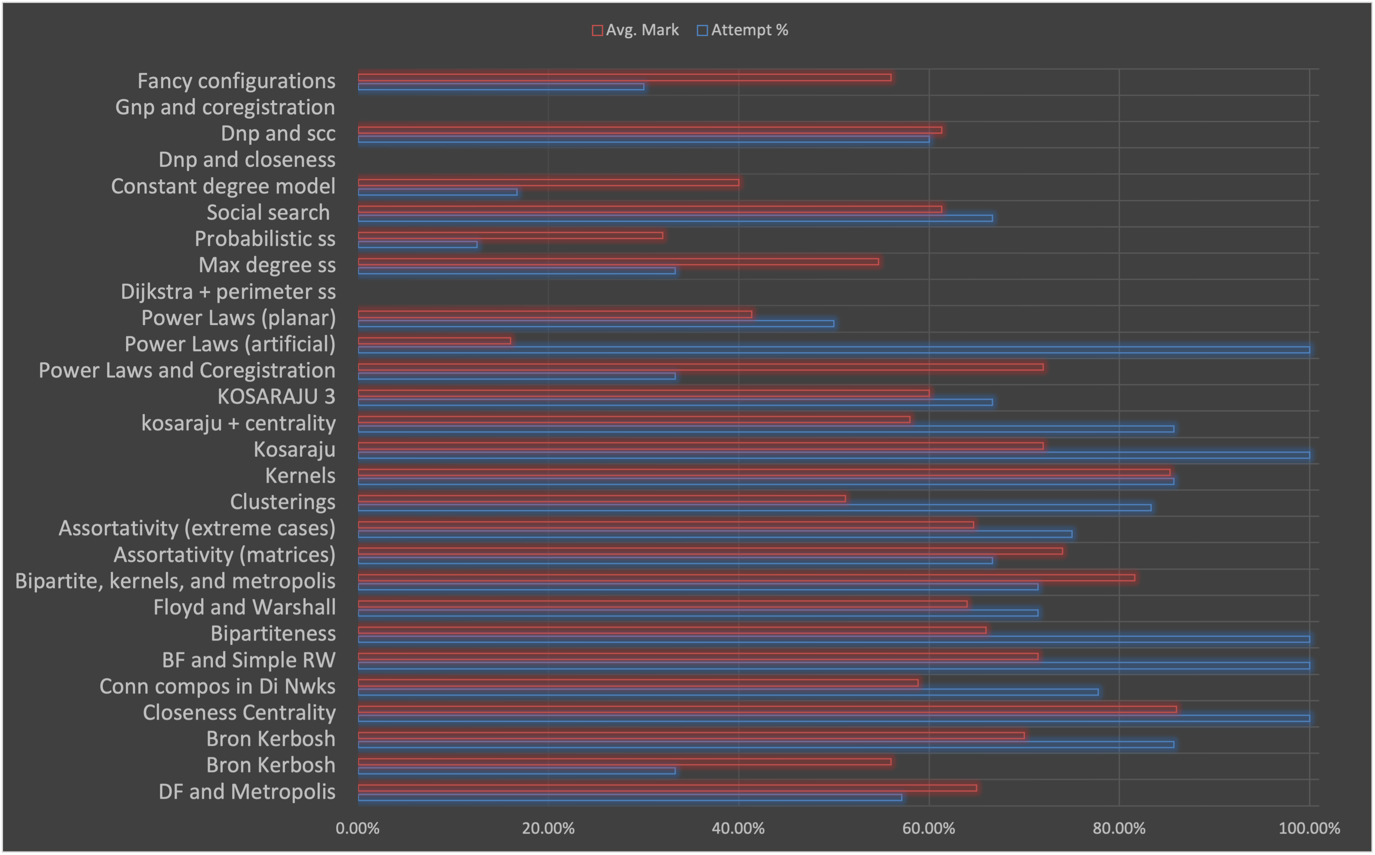
Questions
Questions about Power Laws, the planted degree model, and probabilistic social search were the most difficult.

Slide 17
Questions
Few other questions (mostly from Units 1-3) were well-attended and led to good performances (average marks larger than 60%)

